Slide 1

Basics of Neural Network Programming
Binary Classification
deeplearning.ai

Slide 2
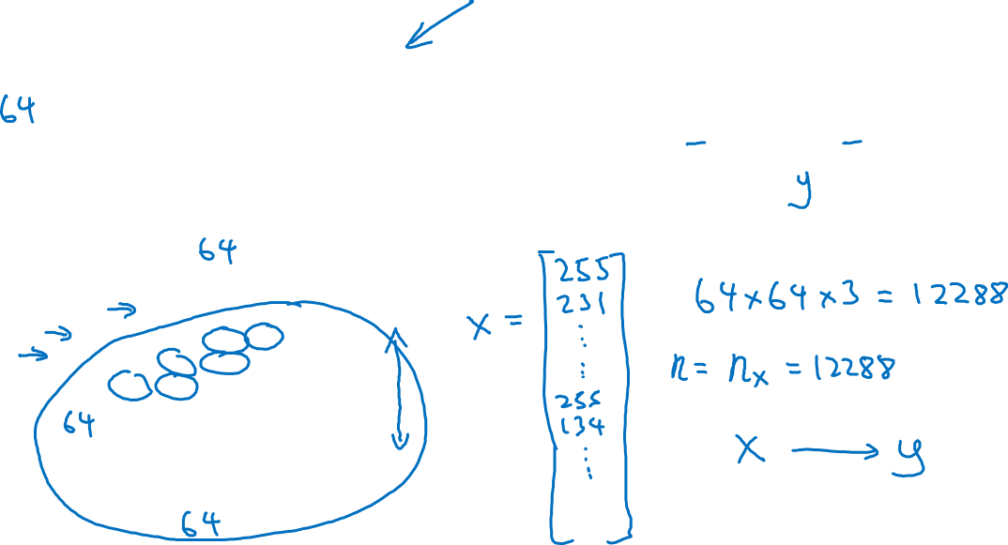
Binary Classification
1 (cat) vs 0 (non cat)
Blue
Green
Red

Slide 3
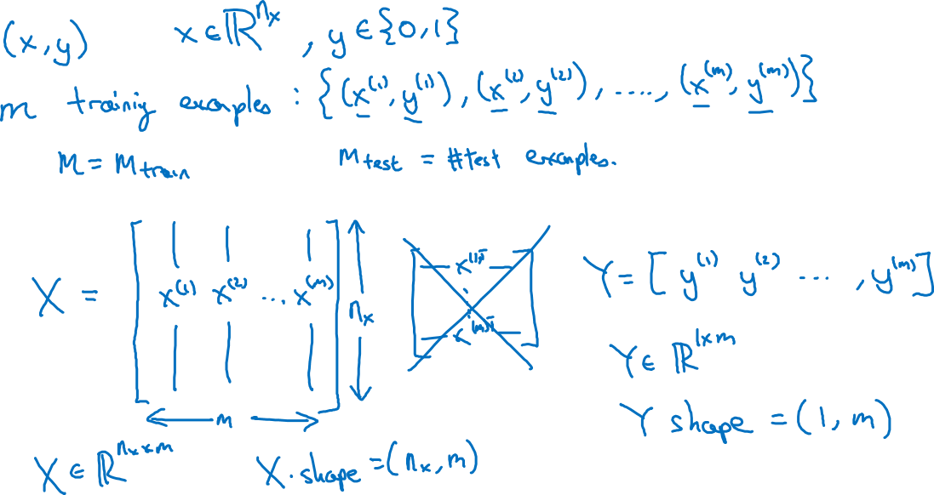
Notation

Slide 4
Basics of Neural Network Programming
Logistic Regression
deeplearning.ai

Slide 5
Logistic Regression

Slide 6
Basics of Neural Network Programming
Logistic Regression
cost function
deeplearning.ai

Slide 7
Logistic Regression cost function
$\hat{y} = σ\left(w^{T}x +b\right)$, where $σ\left(z \right)=\frac{1}{1+e^{−z}}$
Given $\left\{{(x}^{(1)},y^{(1)}\text{)}\text{,}\text{…}\text{,}{(x}^{(m)},y^{(m)}\text{)}\right\},$want ${\hat{y}}^{(i)}≈y^{\left(i\right)}$.
Loss (error) function:

Slide 8
Basics of Neural Network Programming
Gradient Descent
deeplearning.ai

Slide 9
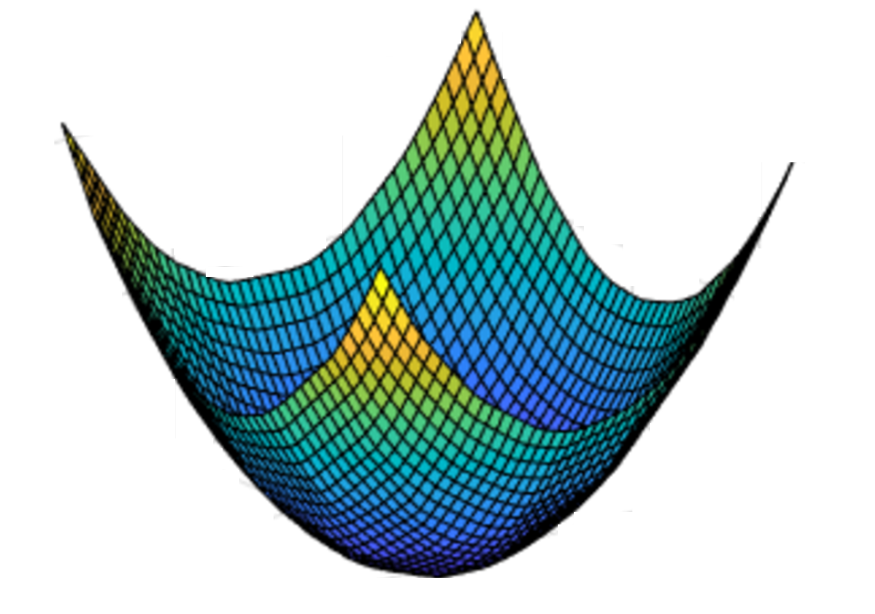
Gradient Descent
Recap: $\hat{y}= σ\left(w^{T}x+b\right)$, $σ\left(z\right)=\frac{1}{1+e^{−z}}$
$$\frac{1}{m}\sum_{i=1}^{m}{ }$$
$ℒ({\hat{y}}^{\left(i\right)},y^{(i)})$ $=$
$$−\frac{1}{m}\sum_{i=1}^{m}{ }$$
$$J\left(w,b\right)=$$
$y^{(i)}\log{{\hat{y}}^{\left(i\right)}}$+ $({1−y}^{(i)})\log{(1 −{\hat{y}}^{\left(i\right)})}$
Want to find $w,b$ that minimize $J\left(w,b\right)$
$$J\left(w,b\right)$$
$$b$$
$$w$$

Slide 10
Gradient Descent
$$w$$

Slide 11
Basics of Neural Network Programming
Derivatives
deeplearning.ai

Slide 12
Intuition about derivatives
$$f\left(a\right)=3a$$
$$a$$

Slide 13
Basics of Neural Network Programming
More derivatives examples
deeplearning.ai

Slide 14
Intuition about derivatives
$$f\left(a\right)=a^{2}$$
$$a$$

Slide 15
More derivative examples

Slide 16
Basics of Neural Network Programming
Computation Graph
deeplearning.ai

Slide 17
Computation Graph

Slide 18
Basics of Neural Network Programming
Derivatives with a Computation Graph
deeplearning.ai

Slide 19
Computing derivatives
$$a=5$$
11
33
$$b=3$$
6
$$v=a+u$$
$J=3v$
$u$=$bc$
$$c=2$$

Slide 20
Computing derivatives
$$a=5$$
11
33
$$b=3$$
6
$$v=a+u$$
$J=3v$
$u$=$bc$
$$c=2$$

Slide 21
Basics of Neural Network Programming
Logistic Regression
Gradient descent
deeplearning.ai

Slide 22
Logistic regression recap
$$z= w^{T}x+b$$
$$\hat{y}=a= σ(z)$$
$$ℒ\left(a,y\right)=−(y\log{(a)+(1−y)\log{(1−a))}}$$

Slide 23
Logistic regression derivatives
$$x_{1}$$
$$w_{1}$$
$$x_{2}$$
$$z= w_{1}x_{1}+w_{2}x_{2}+b$$
$$a= σ(z)$$
$$ℒ(a,y)$$
$$w_{2}$$
b

Slide 24
Basics of Neural Network Programming
Gradient descent
on m examples
deeplearning.ai

Slide 25
Logistic regression on m examples

Slide 26
Logistic regression on m examples

Slide 27
Basics of Neural Network Programming
Vectorization
deeplearning.ai

Slide 28
What is vectorization?

Slide 29
Basics of Neural Network Programming
More vectorization
examples
deeplearning.ai

Slide 30
Neural network programming guideline
Whenever possible, avoid explicit for-loops.

Slide 31
Neural network programming guideline
Whenever possible, avoid explicit for-loops.

Slide 32
Vectors and matrix valued functions
Say you need to apply the exponential operation on every element of a matrix/vector.
$$v= \left[\begin{matrix}v_{1} \\ ⋮ \\ v_{n}\end{matrix}\right]$$
u = np.zeros((n,1))
for i in range(n):
u[i]=math.exp(v[i])

Slide 33
Logistic regression derivatives
J = 0, dw1 = 0, dw2 = 0, db = 0
for i = 1 to n:
$z^{(i)}$ = $w^{T}x^{(i)}+b$
$a^{(i)}$ = $σ{(z}^{(i)})$
$J$+= $−\left[y^{(i)} \log{{\hat{y}}^{\left(i\right)}+({1−y}^{\left(i\right)})\log{(1 −{\hat{y}}^{\left(i\right)})}}\right]$
d$z^{(i)}$ = $a^{(i)}{(1−a}^{(i)})$
d${w_{1}}^{ }$+= $x_{1}^{(i)}\text{d}z^{(i)}$
d${w_{2}}^{ }$+= $x_{2}^{(i)}\text{d}z^{(i)}$
db += d$z^{(i)}$
J = J/m, d$w_{1}$ = d$w_{1}$/m, d$w_{2}$ = d$w_{2}$/m, db = db/m

Slide 34
Basics of Neural Network Programming
Vectorizing Logistic
Regression
deeplearning.ai

Slide 35
Vectorizing Logistic Regression
$$z^{(1)}=w^{T}x^{(1)}+b$$
$$z^{(2)}=w^{T}x^{(2)}+b$$
$$z^{(3)}=w^{T}x^{(3)}+b$$
$$a^{(1)}={σ(z}^{(1)})$$
$$a^{(2)}={σ(z}^{(2)})$$
$$a^{(3)}={σ(z}^{(3)})$$

Slide 36
Basics of Neural Network Programming
Vectorizing Logistic
Regression’s Gradient
Computation
deeplearning.ai

Slide 37
Vectorizing Logistic Regression

Slide 38
Implementing Logistic Regression
J = 0, d$w_{1}$ = 0, d$w_{2}$ = 0, db = 0
for i = 1 to m:
$z^{(i)}$ = $w^{T}x^{(i)}+b$
$a^{(i)}$ = $σ{(z}^{(i)})$
$J$+= $−\left[y^{(i)} \log{a^{\left(i\right)}+({1−y}^{\left(i\right)})\log{(1 −a^{\left(i\right)})}}\right]$
d$z^{(i)}$ = $a^{(i)}{−y}^{(i)}$
d${w_{1}}^{ }$+= $x_{1}^{(i)}\text{d}z^{(i)}$
d${w_{2}}^{ }$+= $x_{2}^{(i)}\text{d}z^{(i)}$
db += d$z^{(i)}$
J = J/m, d$w_{1}$ = d$w_{1}$/m, d$w_{2}$ = d$w_{2}$/m
db = db/m

Slide 39
Basics of Neural Network Programming
Broadcasting in
Python
deeplearning.ai

Slide 40
Broadcasting example
Calories from Carbs, Proteins, Fats in 100g of different foods:
Apples
Beef
Eggs
Potatoes
Carb
$$\left[\begin{matrix}56.0 & 0.0 & \begin{matrix}4.4 & 68.0\end{matrix} \\ 1.2 & 104.0 & \begin{matrix}52.0 & 8.0\end{matrix} \\ 1.8 & 135.0 & \begin{matrix}99.0 & 0.9\end{matrix}\end{matrix}\right]$$
Protein
Fat
cal = A.sum(axis = 0)
percentage = 100*A/(cal.reshape(1,4))

Slide 41
Broadcasting example
$$\left[\begin{matrix}1 \\ \begin{aligned}\begin{matrix}2 \\ 3\end{matrix} \\ 4\end{aligned}\end{matrix}\right]$$
$$\left[\begin{matrix}101 \\ \begin{aligned}\begin{matrix}102 \\ 103\end{matrix} \\ 104\end{aligned}\end{matrix}\right]$$
$$100$$
=
+
$\left[\begin{matrix}1 & 2 & 3 \\ 4 & 5 & 6\end{matrix}\right]$
$$\left[\begin{matrix}100 & 200 & 300\end{matrix}\right]$$
$$\left[\begin{matrix}101 & 202 & 303 \\ 104 & 205 & 306\end{matrix}\right]$$
+
=
$\left[\begin{matrix}1 & 2 & 3 \\ 4 & 5 & 6\end{matrix}\right]$
$$\left[\begin{matrix}100 \\ 200\end{matrix}\right]$$
$$\left[\begin{matrix}101 & 102 & 103 \\ 204 & 205 & 206\end{matrix}\right]$$
+
=

Slide 42
General Principle

